Slide 1
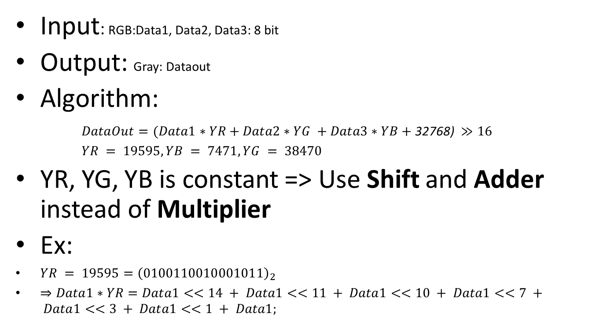
RGB to Gray
Input: RGB:Data1, Data2, Data3: 8 bit
Output: Gray: Dataout
Algorithm:
$DataOut=(Data1∗YR+Data2∗YG +Data3∗YB+\text{32768}\text{) }≫16$
$YR = 19595, YB = 7471, YG = 38470$
YR, YG, YB is constant => Use Shift and Adder instead of Multiplier
Ex:
$YR = 19595={\left(0100110010001011\right)}_{2}$
$⇒Data1∗YR=Data1<<14 + Data1<<11 + Data1<<10 + Data1<<7 + Data1<<3 + Data1<<1 + Data1;$

Slide 2
Data 1
Data 2
Data 3
Mult
Red
Mult
Green
Mult
Blue
Bias
Mout1
Mout3
Mout3
+
+
Temp1
Temp2
+
Temp3
Shift
Data Out

Slide 3
SystemC - VHDL Wrapper
Dual-port RAM
R/W PNG C
RGB2Gray
VHDL
HOG
VHDL

Slide 4
RAM
8
8
8
CLK
RegR
CLK
RegG
CLK
RegB
LoadR
LoadG
LoadB
RGB2Gray
8
RAM

Slide 5
FSM
LoadR
Start/LoadR
1/LoadG
Halt
LoadG
CNT /= 10x10
/ LoadR
1/LoadB
CNT = 10x10
/ Done
StoreS
LoadB
1/Store & Shift

Slide 6
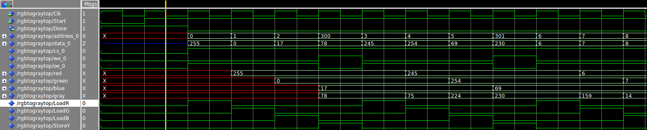
Simulation Result
4 cycle clock

